Slide 1
FORMAL LANGUAGES AND REGULAR GRAMMARS

Slide 2
Grammar
A Grammar is a 4-tuple such that-
G = (V , T , P , S) where-
V = Finite non-empty set of non-terminal symbols
T = Finite set of terminal symbols
P = Finite non-empty set of production rules
S = Start symbol

Slide 3
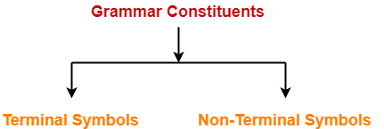
A Grammar is mainly composed of two basic elements-
1. Terminal symbols
2. Non-terminal symbols

Slide 4
1. Terminal Symbols-
Terminals are the basic symbols from which strings are formed.
Terminal symbols are denoted by using small case letters such as a, b, c etc.
2. Non-Terminal Symbols-
Non-terminals are syntactic variables that denote sets of strings.
The non-terminals define sets of strings that help define the language generated by the grammar.
Non-Terminal symbols are also called as auxiliary symbols or variables.
Non-Terminal symbols are denoted by using capital letters such as A, B, C etc.

Slide 5
Grammars
A formal definition of a Grammar consists of :
A finite set of rewriting rules in the form of :
α→β,
where α and β are the strings of symbols.
A special “initial” symbol S (S for Sentence);
A finite set of symbols stand for ‘words’ of language called terminal;
[EXAMPLE: a,b,c……+,-…….etc]
Other symbols stand for ‘phrases’ and are known as non terminals.
[EXAMPLE: A,B,C……]

Slide 6
Chomsky Classification of Grammars
According to Noam Chomsky, there are four types of grammars − Type 0, Type 1, Type 2, and Type 3. The following table shows how they differ from each other
Grammar Type | Grammar Accepted | Language Accepted | Automaton
Type 0 | Unrestricted grammar | Recursively enumerable language | Turing Machine
Type 1 | Context-sensitive grammar | Context-sensitive language | Linear-bounded automaton
Type 2 | Context-free grammar | Context-free language | Pushdown automaton
Type 3 | Regular grammar | Regular language | Finite state automaton

Slide 7
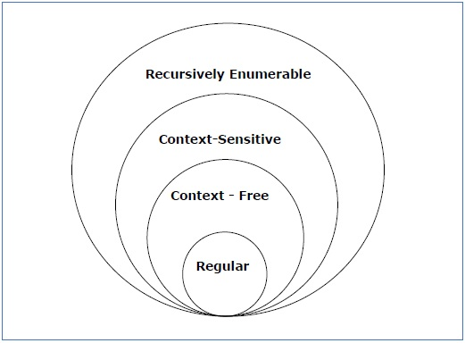
Chomsky Classification of Grammars
It shows the scope of each type of grammar −

Slide 8
REGULAR GRAMMAR
A regular grammar is a formal grammar that is right-regular or left-regular.
Every regular grammar describes a regular language.

Slide 9
TYPES
Right linear regular grammar
Left linear regular grammar

Slide 10
Right Linear Regular Grammar
A right regular grammar (also called right linear grammar) is a formal grammar (N, Σ, P, S) such that all the production rules in P are of one of the following forms:
A → a, where A is a non-terminal in N and a is a terminal in Σ
A → aB, where A and B are non-terminals in N and a is in Σ
A → ε, where A is in N and ε denotes the empty string, i.e. the string of length 0.

Slide 11
Left Linear Regular Grammar
In a left regular grammar (also called left linear grammar), all rules obey the forms:
A → a, where A is a non-terminal in N and a is a terminal in Σ
A → Ba, where A and B are in N and a is in Σ
A → ε, where A is in N and ε is the empty string.
A regular grammar is a left or right regular grammar.

Slide 12
Example-01:
Consider a grammar G = (V , T , P , S) where-
V = { S } // Set of Non-Terminal symbols
T = { a , b } // Set of Terminal symbols
P = { S → aSbS , S → bSaS , S → ∈ } // Set of production rules
S = { S } // Start symbol
This grammar generates the strings having equal number of a’s and b’s

Slide 13
Language Generated by a Grammar
The set of all strings that can be derived from a grammar is said to be the language generated from that grammar.
A language generated by a grammar G is a subset formally defined by
L(G)={W|W ∈ ∑*, S ⇒G W}
If L(G1) = L(G2), the Grammar G1 is equivalent to the Grammar G2.

Slide 14
Example
Let us consider the grammar −
G2 = ({S, A}, {a, b}, S, {S → aAb, aA → aaAb, A → ε } )
Some of the strings that can be derived are −
S ⇒ aAb using production S → aAb
⇒ aaAbb using production aA → aaAb
⇒ aaaAbbb using production aA → aaAb
⇒ aaabbb using production A → ε

Slide 15
Example 1
If there is a grammar
G: N = {S, A, B} T = {a, b} P = {S → AB, A → a, B → b}
Here S produces AB, and we can replace A by a, and B by b. Here, the only accepted string is ab, i.e., L(G) = {ab}

Slide 16
Example 2
Suppose we have the following grammar −
G: N = {S, A, B} T = {a, b} P = {S → AB, A → aA|a, B → bB|b}
The language generated by this grammar −
L(G) = {ab, a²b, ab², a²b², ………}
= {a^{m} b^{n} | m ≥ 1 and n ≥ 1}

Slide 17
2. Which of the following String can be obtained by the language L = {a^i b^2i | i >=1}?
a) aaabbbbbb
b) aabbb
c) abbabbba
d) aaaabbbabb
Notes:
a

Slide 18
3. Let the class of language accepted by finite state machine be L1 and the class of languages represented by regular expressions be L2 then?
a) L1<l2
b) L1>=L2
c) L1 U L2 = .*
d) L1=L2
Notes:
d

Slide 19
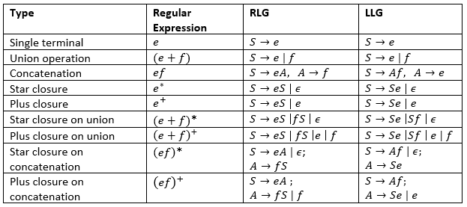
Rules to convert regular expressions to left or right linear regular grammar

Slide 20









Slide 21










Slide 22







FA to RLG and RLG to FA

Slide 23

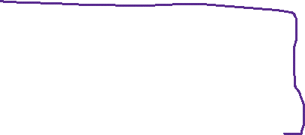
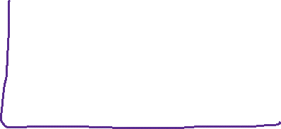






FA to LLG and LLG to FA
Steps:
1: Reverse the direction of edges in FA.
2: make initial to final and final to initial.
3: write the LLG

Slide 24
Conversion of RE to Regular Grammar
Convert the given RE=(a+b)* aa (a+b)* into its equivalent RG.
Convert the given RE=0*1 (0+1)* into its equivalent RG.

Slide 25
PRACTICE QUESTIONS
Suppose, L (G) = {a^{m} b^{n} | m ≥ 0 and n > 0}. We have to find out the grammar G which produces L(G).
2. Suppose, L (G) = {a^{m} b^{n} | m > 0 and n ≥ 0}. We have to find out the grammar G which produces L(G).

Slide 26
Example-02:
Construct right and left linear grammars for the language, L={a^n b^m, n>=2, m>=3}

Slide 27
Practice Questions
Convert the following RE into RG:
a*
a+0
(ab)*
a* + 1 + b+
0*(1 (0+1))*

Slide 28
Type - 2 Grammar
Type-2 grammars generate context-free languages.
The productions must be in the form
A → γ
where A ∈ N (Non terminal) and γ ∈ (T ∪ N)* (String of terminals and non-terminals).
These languages generated by these grammars are be recognized by a non-deterministic pushdown automaton.

Slide 29
Example
S → X a
X → a
X → aX
X → abc
X → ε

Slide 30
Practice Questions
Convert the following RE into CFG:
a*
a+0
(ab)*
a* + 1 + b+
0*(1 (0+1))*

